Slide 1

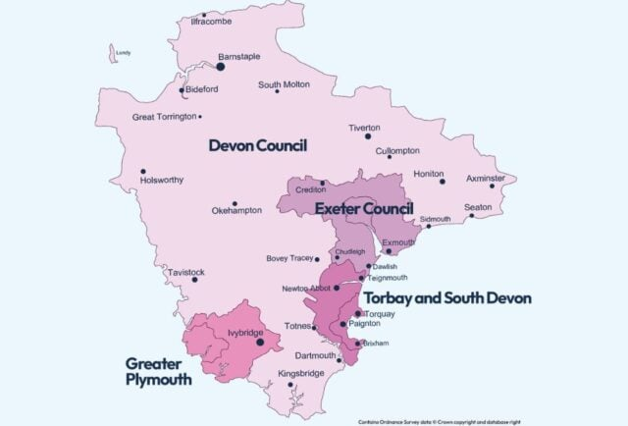

Local Government Reorganisation

Slide 2


Timeline & Phasing
Today
Yrs 2-4
2029/30/31
End Yr 1
March 2029
Vesting
Day
1st April 28
Shadow
Elections
6th May 27
New Unitaries
Decision
Point
July 26
Proposals Submitted
Nov 25
Shadow Authorities
Joint Committees
Existing Councils
Consolidate | Collaborate | Transfer | Transition | Transform

Slide 3
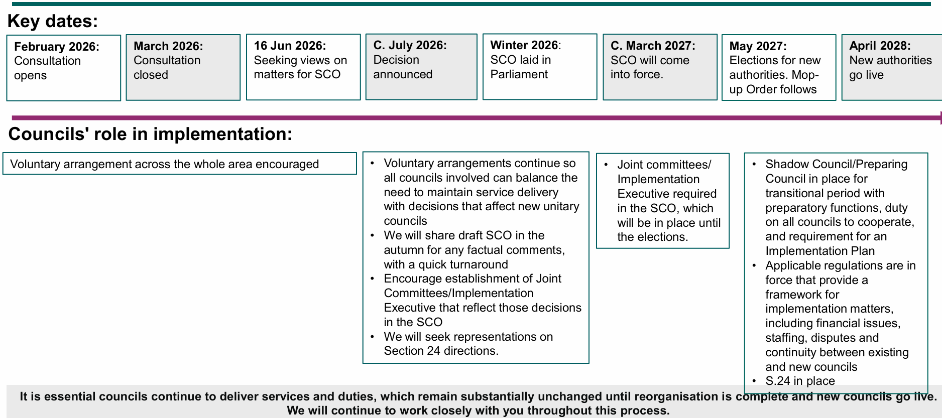
Key dates – governance and legal framework

Slide 4
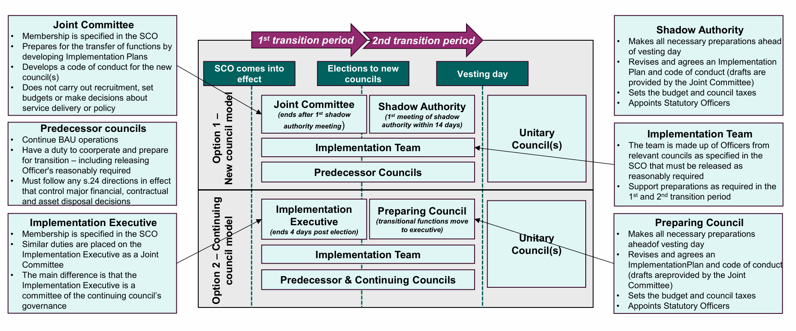
Transitional Governance, Roles and Responsibilities

Slide 5
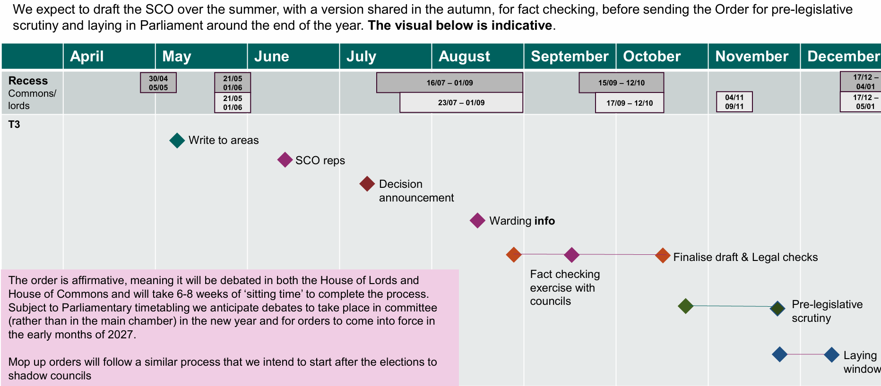
Structural Changes Order – legal framework
- indicative timeline

Slide 6
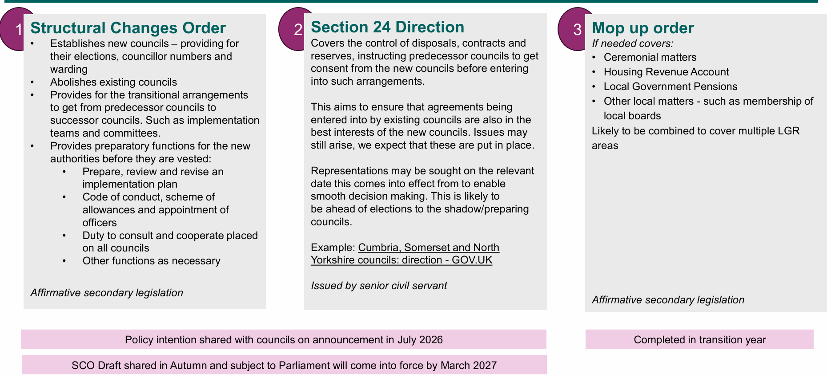
Implementation orders and directions – 3 types

Slide 7
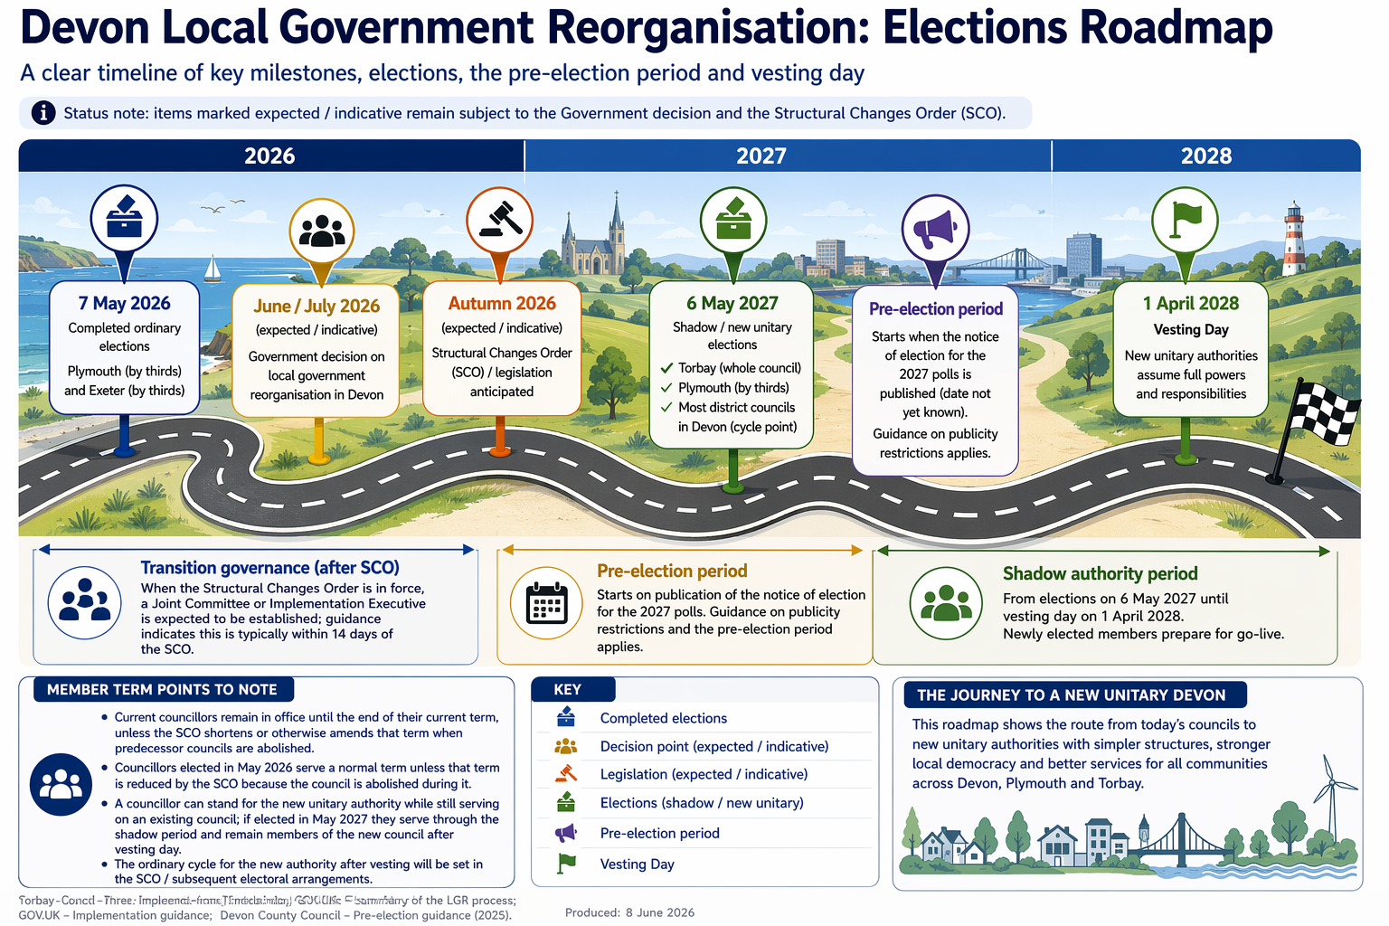

Slide 8


Slide 9

Working Together – current work
Devon County Council’s Chief Executive is the Senior Responsible Officer
8 Themes have been agreed on for preparatory work with each being led by a CEX or Director and a team of colleagues across the councils are being drawn together – includes Communication and engagement.
Programme Director recruited (Lewis Gabb), and a Project Management Office is being established
A Strategic Partner (KPMG) is providing additional capacity as needed to support all councils through the process
Regular engagement with Government’s appointed Sector Lead and across national networks, learning best practice
Each council is developing their internal programme structure to support the area-wide activity, mirroring the same themes and activities
There is good collaboration and co-operation and strong areas of consensus
300 Councillors (86 Exeter, 64 Torbay & South Devon, 68 Greater Plymouth, 103 Devon)

